Slide 1
Unsupervised Curricula for Visual Meta-Reinforcement Learning
Allan Jabri, Kyle Hsu, Ben Eysenbach, Abhishek Gupta, Sergey Levine, Chelsea Finn
NeurIPS 2019

Slide 2
Goal: Prepare a visuomotor agent with useful RL strategies by pre-training with self-generated tasks.

Slide 3
The Need to Generalize
C elegans
(the environment is dynamic / changing)
Left: show c elegans doing infotaxis
Right: show new Caledonian crow using tools (generalizing)

Slide 4
Generalization and Transfer
We want to efficiently build systems that generalize
Transfer of function
Requirement of less direct supervision
Multi-task learning
Meta-learning
Continual learning
Unsupervised learning
…

Slide 5
From Specialists to Generalists
Visuals showing one of each

Slide 6
Multi-task Reinforcement Learning
Contextual Policies
Condition policy on
given task description
e.g. a goal
Meta-learning for RL
Condition policy on
description of task inferred
from data collected by policy
more general

Slide 7
Meta-Reinforcement-Learning
Task Inference
Condition policy on
description of task inferred
from data collected by policy
learn to explore,
to best exploit
learn to associate stimulus and reward

Slide 8
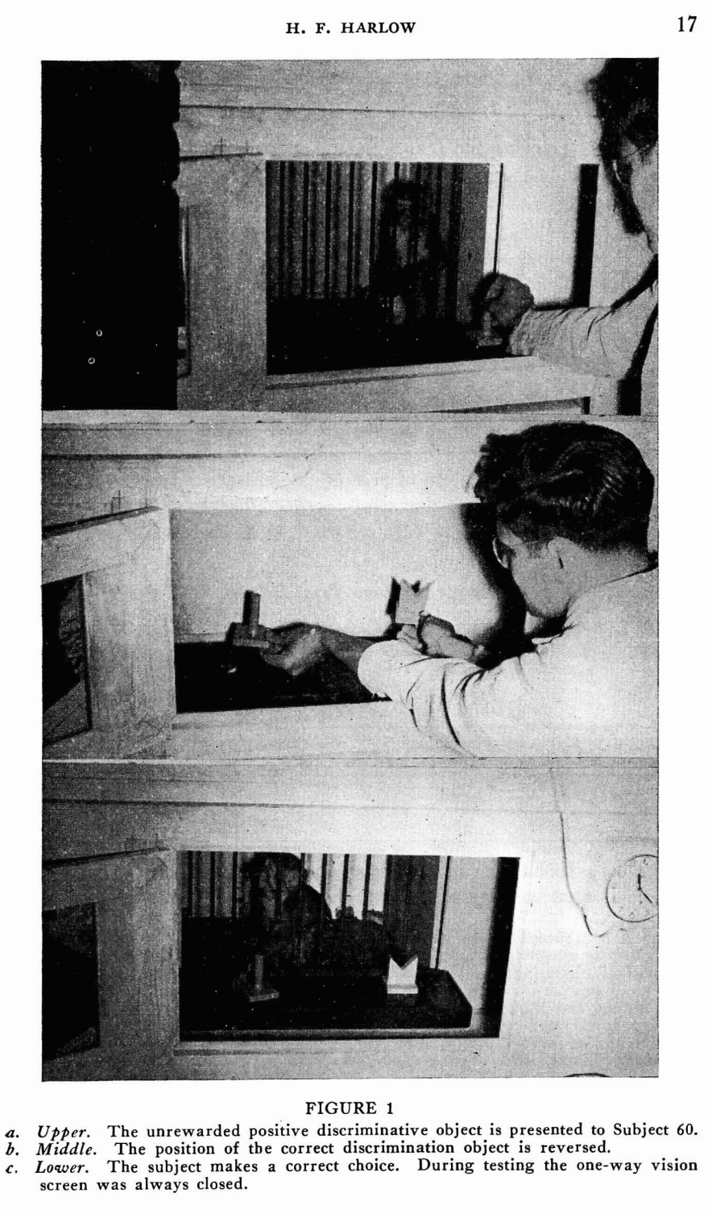
Meta-RL from Pixels
The formation of learning sets. 1949

Slide 9
The Task Distribution
Meta-training tasks determine nature of acquired task inference and execution strategies
–> extent of potential transfer
–> tedious to enumerate, tricky to design
[Meta-RL objective], point towards the sampling from T

Slide 10
Can we learn useful RL strategies via task distributions formed from unsupervised interaction?

Slide 11
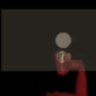
Goal: Prepare a visuomotor agent with useful RL strategies by pre-training with self-generated tasks.
Task acquisition
Unsupervised learning and exploration in task space
Meta-learning
Learning to operationalize skills to solve tasks
Prior work: Treat separately, from ground-truth low-dim state
Notes:
Most of life is independent study

Slide 12
Challenges
Meta-training tasks determine nature of acquired task inference and execution strategies
–> determines extent of potential transfer
–> tedious to enumerate, tricky to design
[putMeta-RL objective], point towards the sampling from T

Slide 13
EVERYTHING HEREAFTER IS ROUGH

Slide 14
Criteria for Tasks

Slide 15
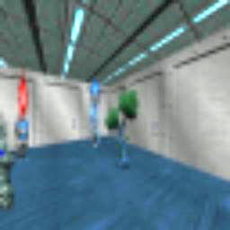
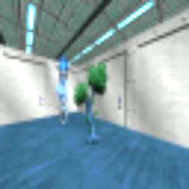
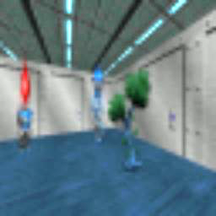
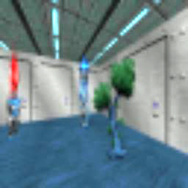
Data
+
1. Organize
2. Meta-Train
+
Update task scaffold
+
Acquire skills and explore
Tasks

Slide 16
Organize
+
+
+
Practice

Slide 17
Organize <-> Practice
Organization: Model current behavior
Compress current behavior into shorter description – “skills”
Ex: Fit density model of behavior
Practice: Acquire Skills
Learn tasks derived from model of current behavior
Ex: Learn reward functions derived from the density model
Exploration: Expand frontier of behavior
Novelty w.r.t current model
Notes:
Exploration will be reflect in the data distribution used to organize next set of skills
Accumulate tasks

Slide 18
Contributions
Method for producing task distribution, scaling to visual environments
Discriminative Clustering
Effective meta-learning of unsupervised task distribution
Positive transfer to downstream test tasks and accelerated learning on target task distributions

Slide 19
An Automatic Curriculum
Repeat
Organize Behavior
Babble current behavior
Update density model of behavior
Practice [+ Explore]
Learn updated task distribution
Explore based on density model

Slide 20
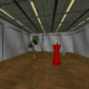
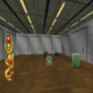
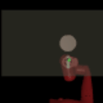
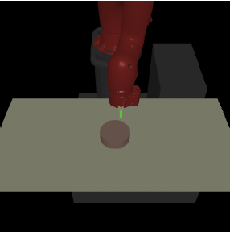
Settings
Visual Navigation in VizDoom
MuJoCo Sawyer w. position control

Slide 21
Organize
Organization as Information-Maximization
Noisy Channel
Trajectory of states
Z

Slide 22
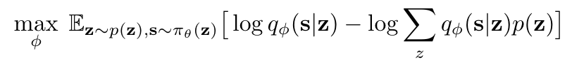
Organize
Organization as Information-Maximization
Fit a deep mixture model to trajectories of current behavior
EM for jointly learning visual representation and trajectory-level clustering
Assume states to be conditionally independent given skill (why?)

Slide 23
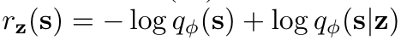
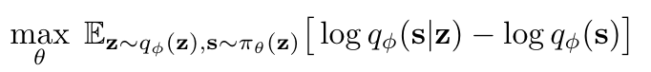
Practice
Construct reward functions from our mixture model
Train policy on task distribution
Notes:
Train our policy to reproduce behavior that we’ve seen in the past
From transient behavior to operationalizable skills

Slide 24
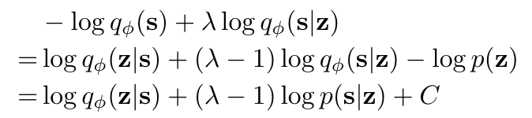
Explore
+
+
Since we have density, we can augment reward function with exploration bonus
+

Slide 25
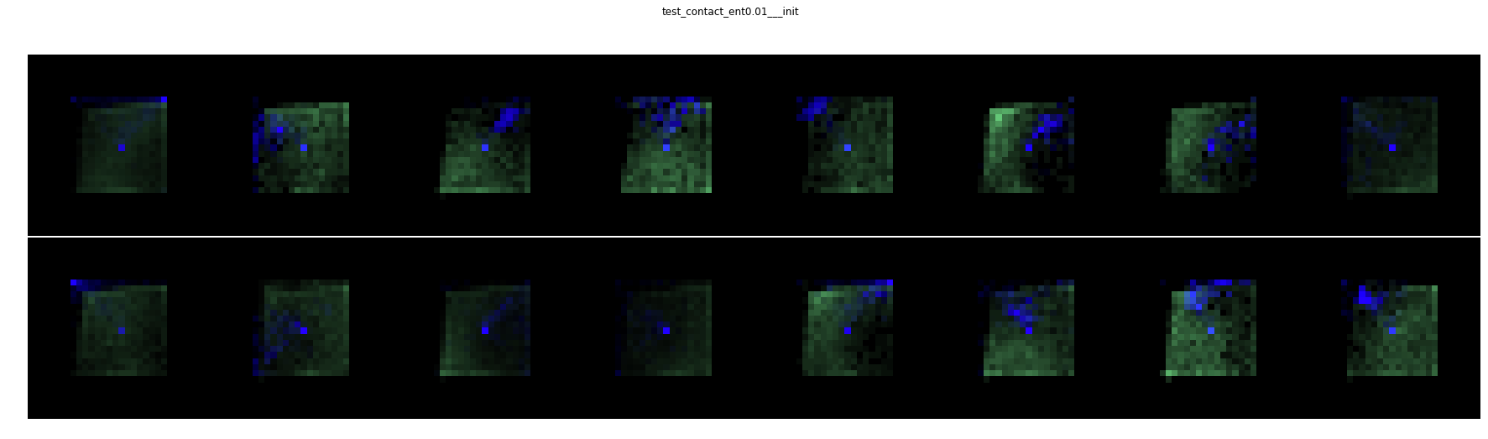
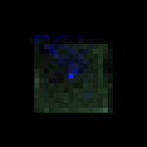
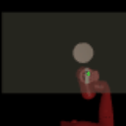


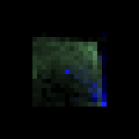
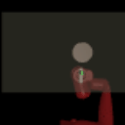
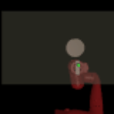
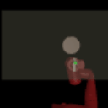
Cluster 12
Cluster 3

Slide 26
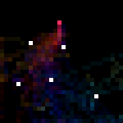
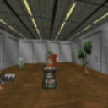
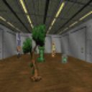
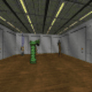
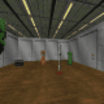
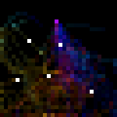
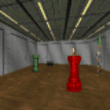
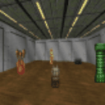
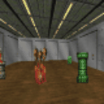
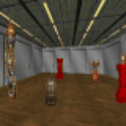

Slide 27
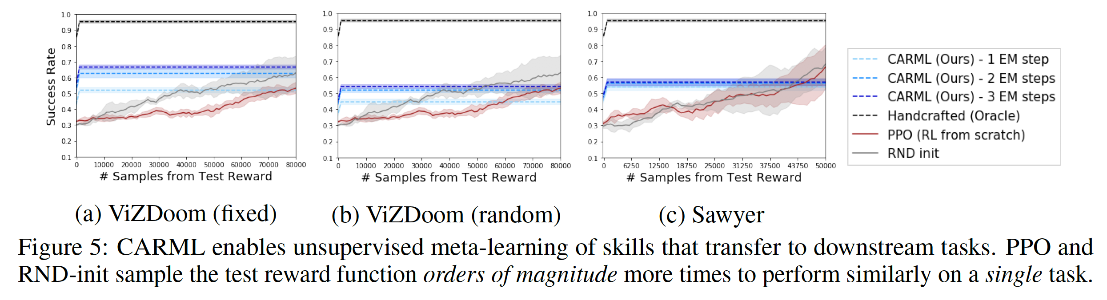
Transfer to Test Task distributions
Apply policy on test object-direct navigation tasks.
Given an environment, randomly sample an object as goal.
Reward function is inverse distance to object.

Slide 28
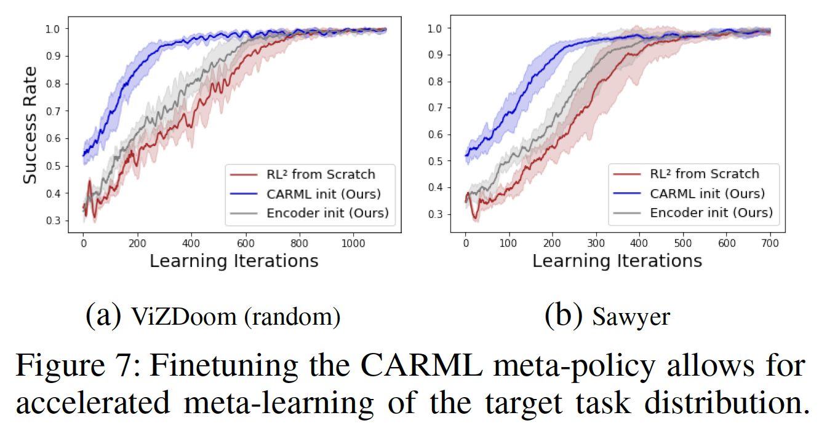
Transfer as Parameter Initialization

